Slide 1
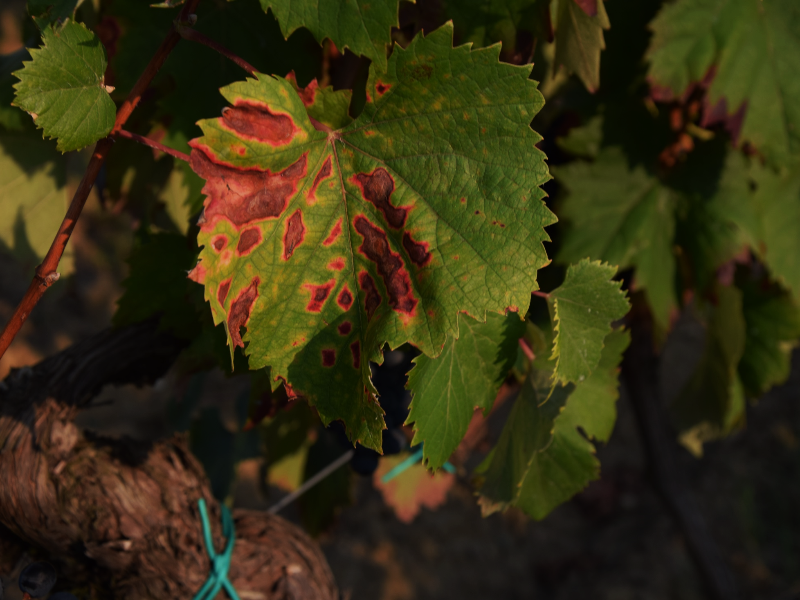
Grapevine Trunk Diseases
To manage the disease
This project has received funding from the European Union's Horizon 2020 research and innovation programme under grant agreement N°652601

Slide 2
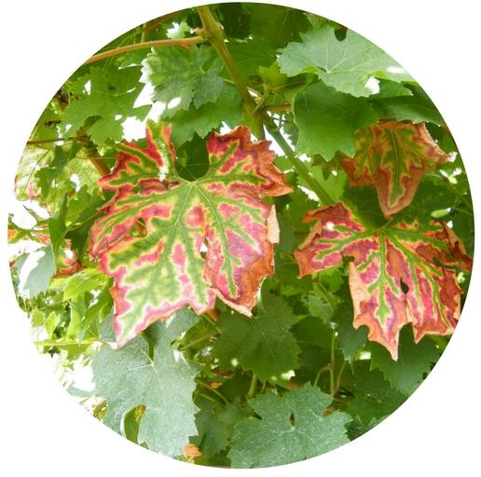
Grapevine Trunk Diseases
What are they?
GTDs are a group of fungal diseases that affects the perennial organs of the plant, leading to leaf and berries symptoms and sometimes also to the death of the plant

Slide 3
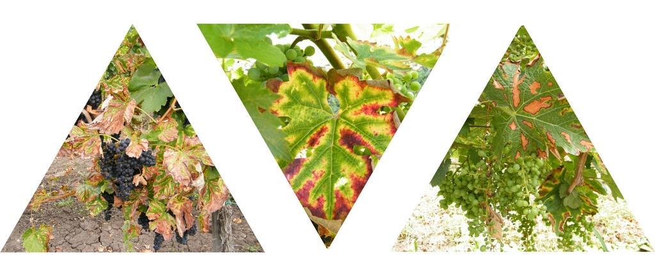
Grapevine Trunk Diseases
Why should we care?
GTDs cause huge economic losses (1,5 billion $ per year due to re-plantation worldwide), leading to production decrease (1 billion€ in France per year) in both quality and quantity
Notes:
Cost extimated in order to re-plant the vines that get infected every year.
While the economic loss of a billion Euros in France is due to the production decrease in both quality and quantity. The same goes for California (0,25 billion Dollars) and For Australia (8,3 billion dollars).

Slide 4
Grapevine Trunk Diseases
Why should we care?
Vineyard:
Loss of production, plant death and increased re-implantation costs
Winemaking:
Quali-quantitative damages in wine production (< sugar , >pH etc)
Notes:
In Addition to a smaller production also the quality of the grapes is reduced. Very important is the fact that the pH is higher. It is advisable not to use the grapes that come from an infected plant

Slide 5
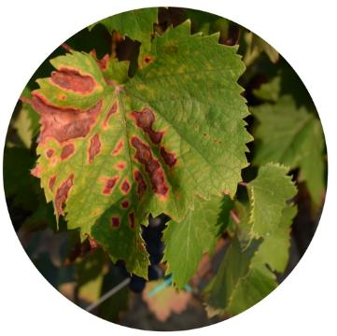
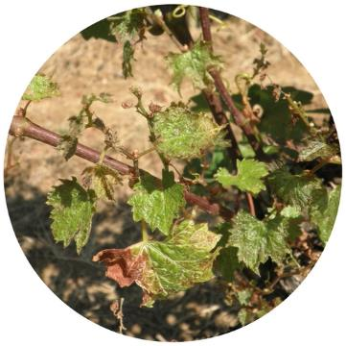
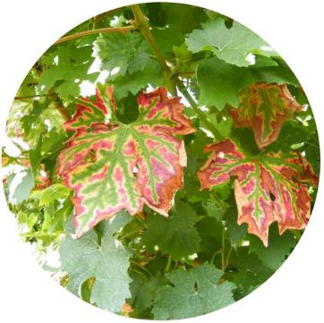
Grapevine Trunk Diseases
Who are they? (adult vineyard)
Botryosphaeria
Eutypa
Esca complex
Delayed growth
Chlorosis on the leaves
Stunted development
Strong Chlorosis on the leaves
Striped leaves
Black spots on the berries

Slide 6
Grapevine Trunk Diseases
How to manage the disease
In order to fight the grapevine trunk diseases prevention is the key to success

Slide 7
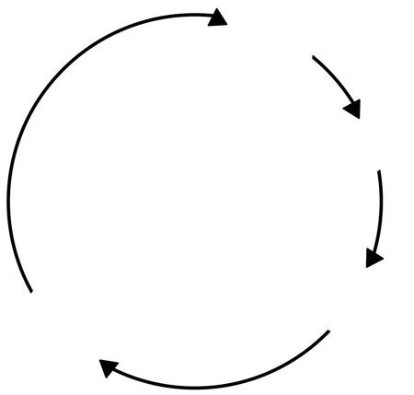
Grapevine Trunk Diseases
Prevention strategies
In order to prevent the GTDs diffusion is important to know how the infections work
Winter
Inoculum ready
Pruning wounds
Spread by rain
Autumn
Spring
Infection
Reproduction
Summer

Slide 8
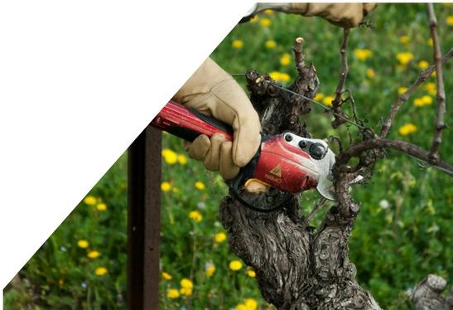
Grapevine Trunk Diseases
Prevention strategies
Knowing that the GTDs pathogens infect the plants mainly through the pruning wounds is possible to prevent the infection with the following practices:
Reducing the inoculum
Pruning in a dry period
Protection of the pruning wounds

Slide 9
Grapevine Trunk Diseases
Reducing the inoculum
In order to have a lower inoculum in the field is important to remove the infected plants and the pruning residuals from the plot, and if possible to compost or burn them.

Slide 10
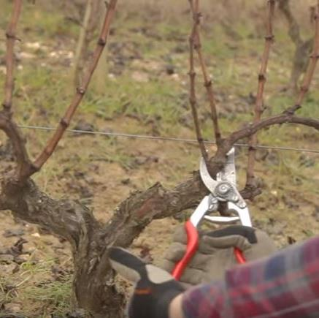
Grapevine Trunk Diseases
Reducing the inoculum
Knowing that the GTDs pathogens infect the plants mainly through the pruning wounds, is important to prune when the dispersion of the inoculum would be the lowest, that is during a dry period.

Slide 11
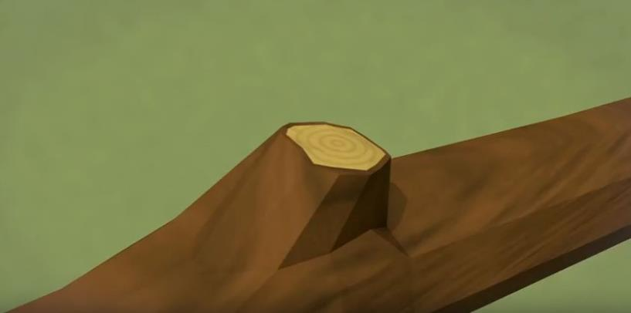
Grapevine Trunk Diseases
Shielding the pruning wounds
A good practice to reduce the infections is to block the entrance of the pathogens trough the pruning wounds, this could be done with a chemical or a biological agent.

Slide 12
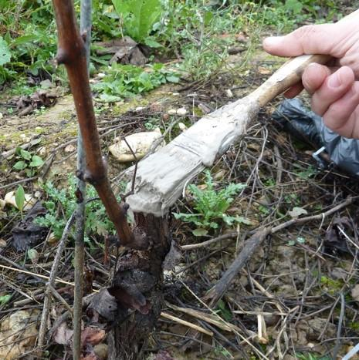
Grapevine Trunk Diseases
Shielding the pruning wounds
Mastic is used to block the entrance of pathogens in the plant; it is a practice with an high success rate, but it is very slow and time consuming.

Slide 13
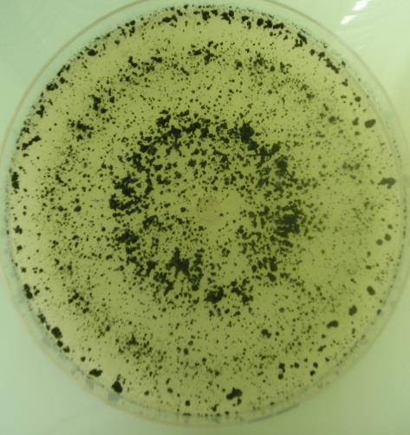
Grapevine Trunk Diseases
Shielding the pruning wounds
Trichoderma spp. is a microorganism that is able to rapidly colonize an infected wound. In the recent years more studies have been done on its usage.

Slide 14
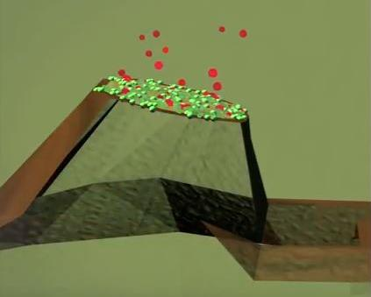
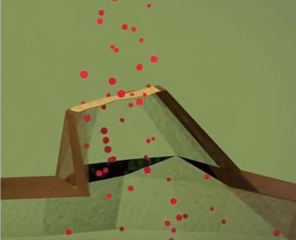
Grapevine Trunk Diseases
Shielding the pruning wounds
For its ability to rapidly colonize a wound, Trichoderma spp. is used as a biological barrier on a wound.
This microorganism forms a shield that the pathogens are not able to penetrate.
Treated
Non-Treated

Slide 15
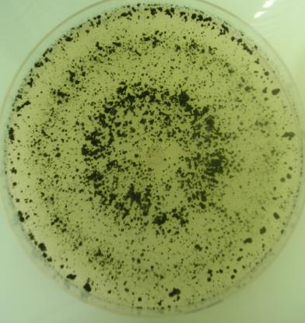
Grapevine Trunk Diseases
Shielding the pruning wounds
The use of Trichoderma is strongly recommended since:
It is usable in organic viticulture
It gives good results in shielding the wounds
It could be sprayed
It is fast and cheaper that the mastics

Slide 16
Grapevine Trunk Diseases
Shielding the pruning wounds
Notes:
Decide if use it or not

Slide 17
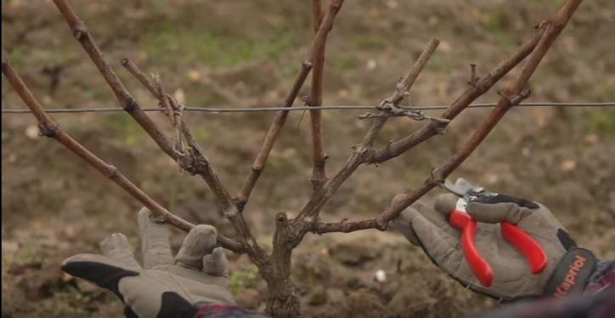
Grapevine Trunk Diseases
Alternative pruning
A practice that could be adopted to reduce the damages of GTDs is the pruning respecting the sap flux.
Having a better flux of sap in the plant might reduce the clogging of sap due to the GTDs pathogens.
More info at: http://www.winetwork-data.eu/intranet/libretti/0/libretto16497-01-1.pdf

Slide 18
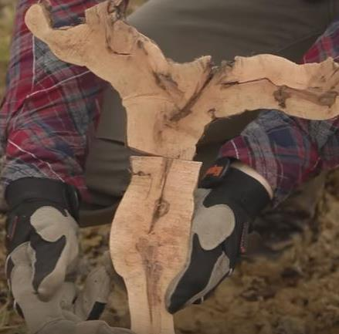
Grapevine Trunk Diseases
Alternative pruning
Gouyot Poussard is considered to be a good pruning system to reduce GTDs damages.
On this pruning system there is no precise scientific evidence

Slide 19
Grapevine Trunk Diseases
Quiz
Please answer to the given questions
Notes:
(15 minutes)

Slide 20
Grapevine Trunk Diseases
video

Slide 21
Grapevine Trunk Diseases
Quiz
Results and Discussion

Slide 22
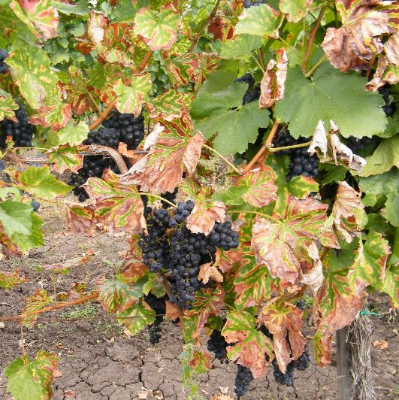
Grapevine Trunk Diseases
Managing infected vines
If you did not succeed in preventing the infection, is still possible to cure an infected plant, but since the success ratio is never 100% those techniques are not scientifically validated.

Slide 23
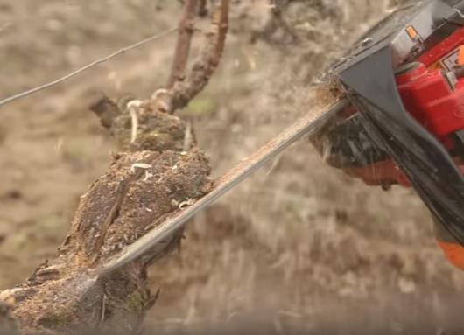
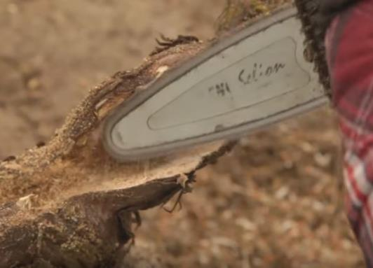
Grapevine Trunk Diseases
Trunk cleaning or curettage
This technique consist in opening the trunk with a chainsaw, in order to expose the infected area.
Then using a smaller chainsaw the infected wood is removed.

Slide 24
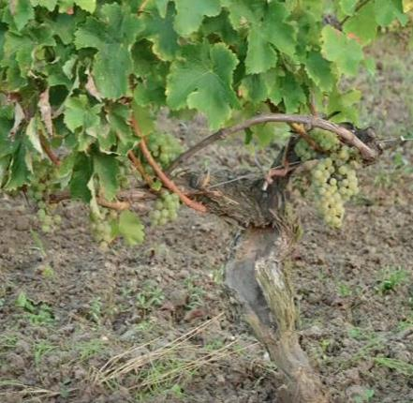
Grapevine Trunk Diseases
Trunk cleaning or curettage
This technique gives good and fast results, but it is expensive, time-consuming and the help of specialized worker is needed.
Notes:
This technique is the fastest compared to TTR and over grafting

Slide 25
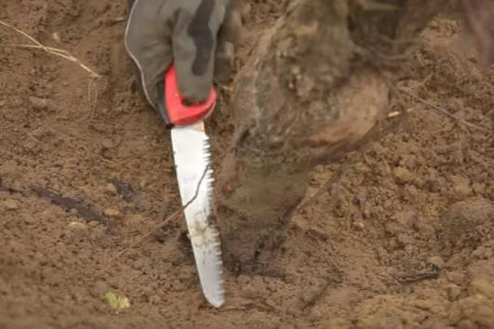
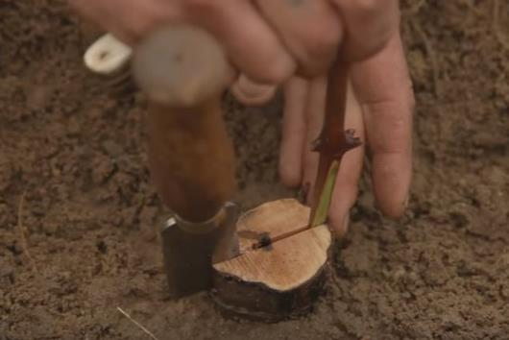
Grapevine Trunk Diseases
Over grafting
This technique consists in cutting the trunk below the grafting point; then a new graft with two scions is made.

Slide 26
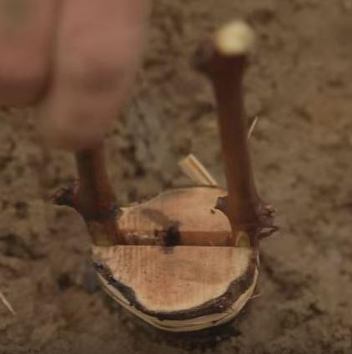
Grapevine Trunk Diseases
Over grafting
This technique gives good results and there is no need of special equipment, the problem is that is very time consuming.

Slide 27
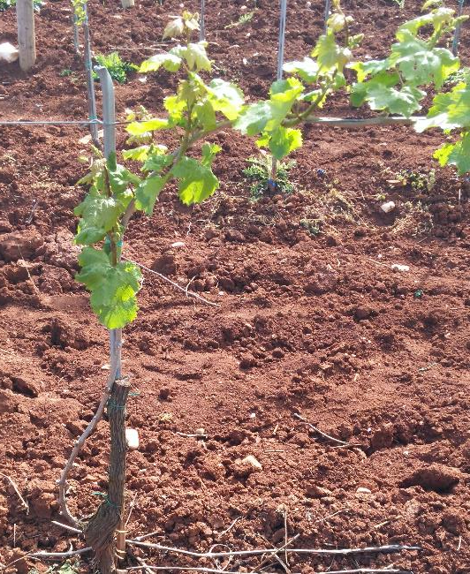
Grapevine Trunk Diseases
Timely trunk renewal
Timely Trunk Renewal is a practice that consists in cutting the trunk and use a sucker to replace it.
This practice is particularly effective against Eutypa, it doesn't need the help of specialized workers, but is time consuming.

Slide 28
Grapevine Trunk Diseases
Managing infected vines
Trunk cleaning, over grafting and TTR could be effective only when the infection did not spread also in the root system.

Slide 29
Grapevine Trunk Diseases
Managing infected vines
There are other three methods that are starting to get popular, even though they are not scientifically validated. They will be shown in the following pages

Slide 30
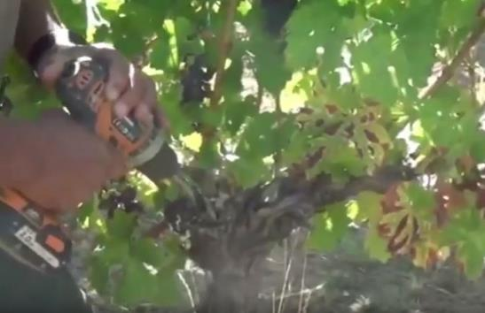
Grapevine Trunk Diseases
H₂O₂ Injections
Many European winegrowers use this method, that consists in drilling a hole in the trunk and injecting 3-4 ml of H₂O₂ inside the infected plant.

Slide 31
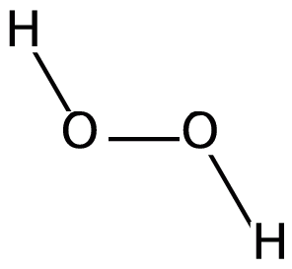
Grapevine Trunk Diseases
H₂O₂ Injections
Winegrowers say that this technique is effective, it have a low cost and it is fast, still there is no scientific evidence of its effect.

Slide 32
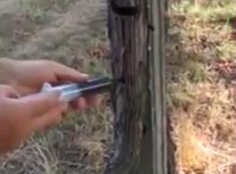
Grapevine Trunk Diseases
Cu nanoparticles injection
Some European winegrowers use this method, that consists in drilling a hole in the trunk and injecting a solution of Copper nanoparticles inside the infected plant. The results look promising, but there is still the need of more investigation on this technique.

Slide 33
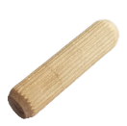
Grapevine Trunk Diseases
Trichoderma wood dowels
This technique consists in drilling one or more holes on an infected plant and to insert small wood dowels inoculated with Trichoderma.
This technique is not validated and needs more scientific trials.

Slide 34
Grapevine Trunk Diseases
Quiz
Please answer to the given questions
Notes:
(15 minutes)

Slide 35
Grapevine Trunk Diseases
video

Slide 36
Grapevine Trunk Diseases
Quiz
Results and Discussion

